Slide 1








FOOD PLACES RECOMMENDATION BASED ON EMOTIONS
datamining project

Slide 2

TEAMS
Dominic Ferrando
Tram Le
Priyank Shah
Chad Losey

Slide 3


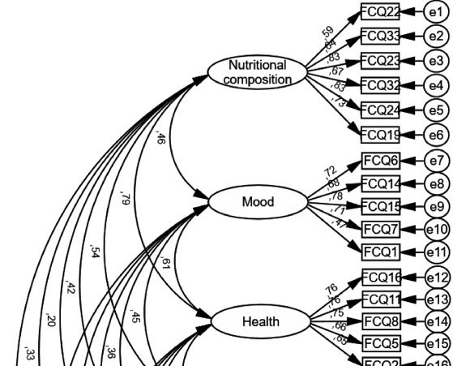


INTRODUCTION
College students face issues like depression due to having bad eating habits or lack of healthy eating
Food-insecure students had an average GPA of 3.33 out of 4.0
A high connection of nutrition and mood is important for college students
We want to link college student emotions to the food options by using recommendation system

Slide 4






BACKGROUND
description
technology
Develop a web based interface along with recommendation system using data mining techniques
Display emotions(icon) such as happy, stress, bored, tired, etc.., selected based on the user’s current mood. Then the system will provide suggestions for restaurants that fit the food options near campus.
Python libraries/framework such as scikit-learn, numpy, pandas, matplotlib to plotting,.....
HTML+CSS, Python Flask framework for interface
Github to deploy our application

Slide 5


METHODOLOGY
Utilize Data Mining Techniques and Machine Learning Algorithm
Data Processing, Cleaning, Preparing
BERTopic unsupervise clustering
Supervise Learning (Logistic Regression/Decision Trees)
K-Means
Text Processing with NLTK (Stopwords, Lemmatizer)
Plotting and Visualization
Geospatial (distance between two data points)
Content and Distance based filtering for recommendation

Slide 6

DATASET
‘yelp’ and ‘Food Code’ on Kaggle
yelp_business.json
food_coded.csv
150,346 businesses in dataset Information and rating
103 businesses without categories
over 125 records (survey from college students
Project uses almost all atributes such as name, address, longitude, latitude, rating,..
GPA, gender, weight, food interesting,.....
Project use ‘comford_food’ and ‘food_reason’

Slide 7







DATA EXPLORATION IN FOOD
Read dataset
Prepare the dataset for analasys
Find the distribution of GPA and Weight by Gender visualization
Clean all the nan value

Slide 8
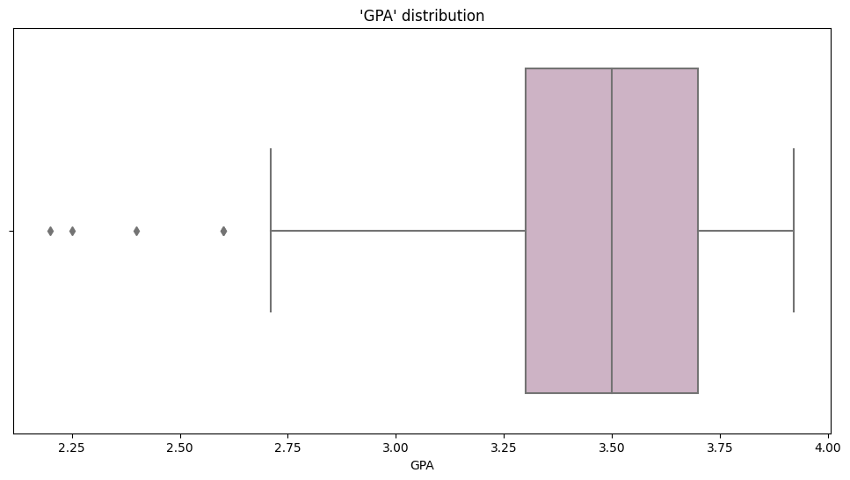


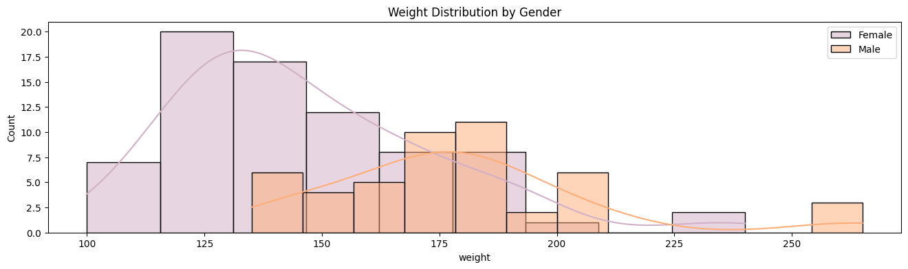

DISTRIBUTION VISUALIZE

Slide 9
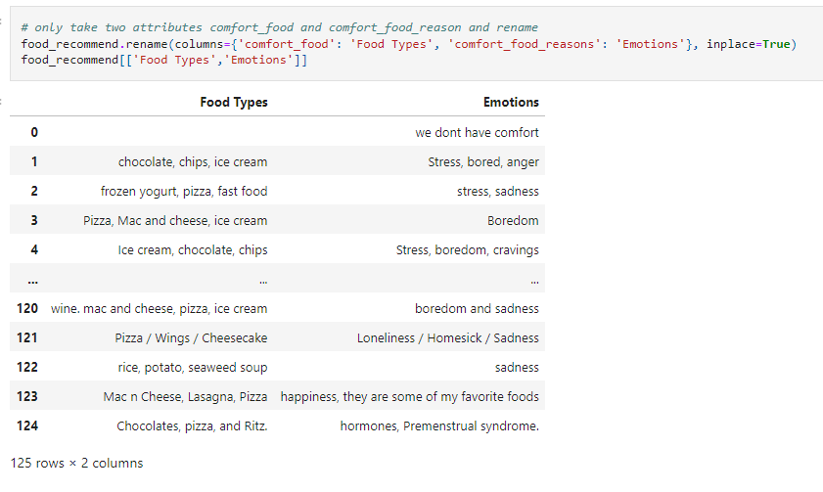
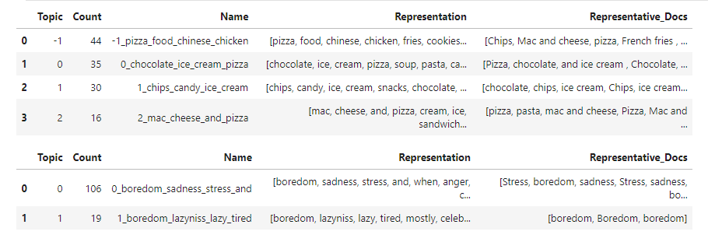

ANALYSIS
The project uses: comford_food and food_reason
Clean all the nan value
Explore BERTopic for food and emotion: embeddings and ML clustering algorithms to generate topics from a collection of documents
Correction between food topics and emotion on Bert

Slide 10


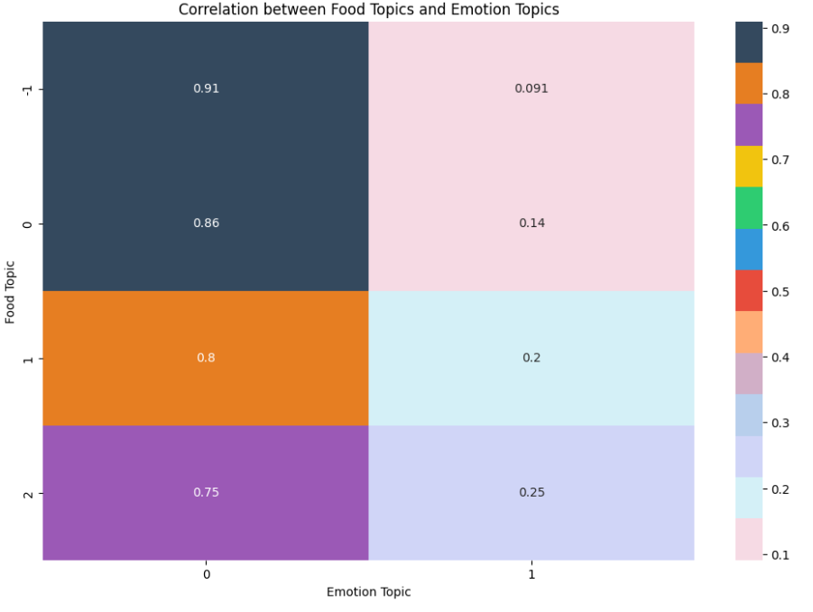
CORRECTION VISUALIZE

Slide 11


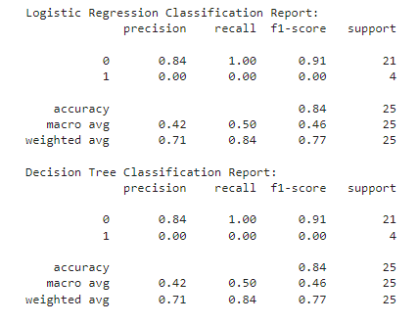
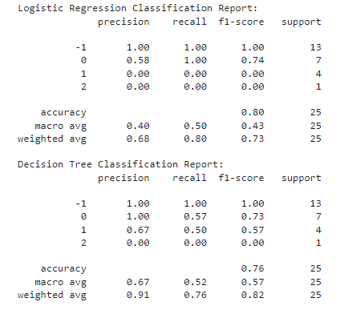

SUPERVISE LEARNING ON TOPICS
emotion topic
food topic

Slide 12
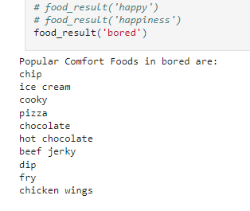
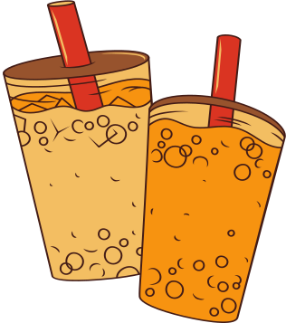
TEXT PROCESSING
NLTK: popular Python library used for working with human language data (NLP)
Use to extract the popular food recommendations for a given emotion category
Apply NLTK Stopwords to filter out all common words
Apply NLTK Lemmatizer to reduce or filter the part in words base on it root

Slide 13
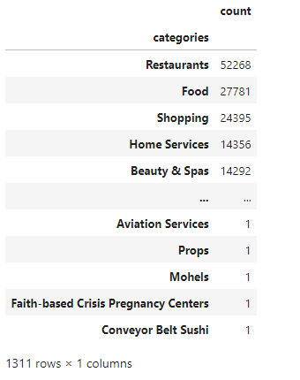

DATA EXPLORATION IN RESTAURANT
Convert and read dataset
Clean all the nan and empty value
Prepare the dataset for analasys
Sort all the category exist in dataset
Use a Filter Process for Restaurant and Food Businesses

Slide 14

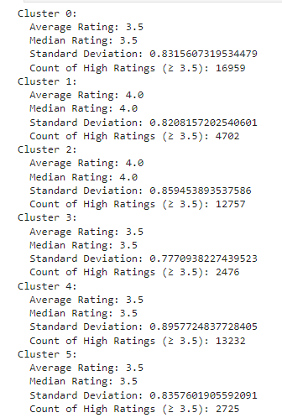
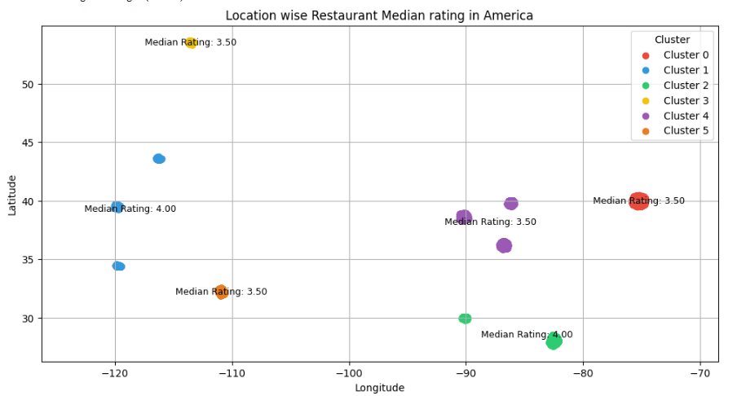
K-MEANS
Apply to cluster where popular restaurants are located in the USA
Apply median of ratings and the standard deviation to ensure the stability and quality of clusters

Slide 15
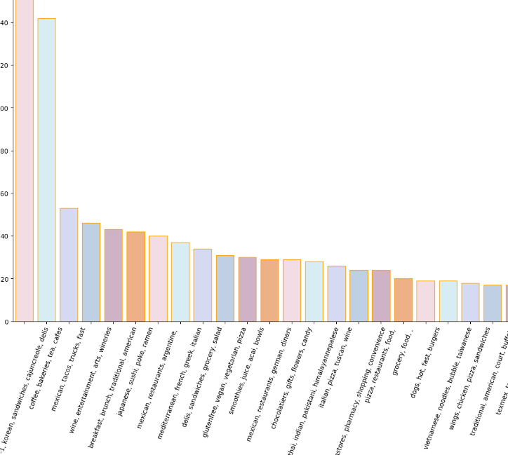
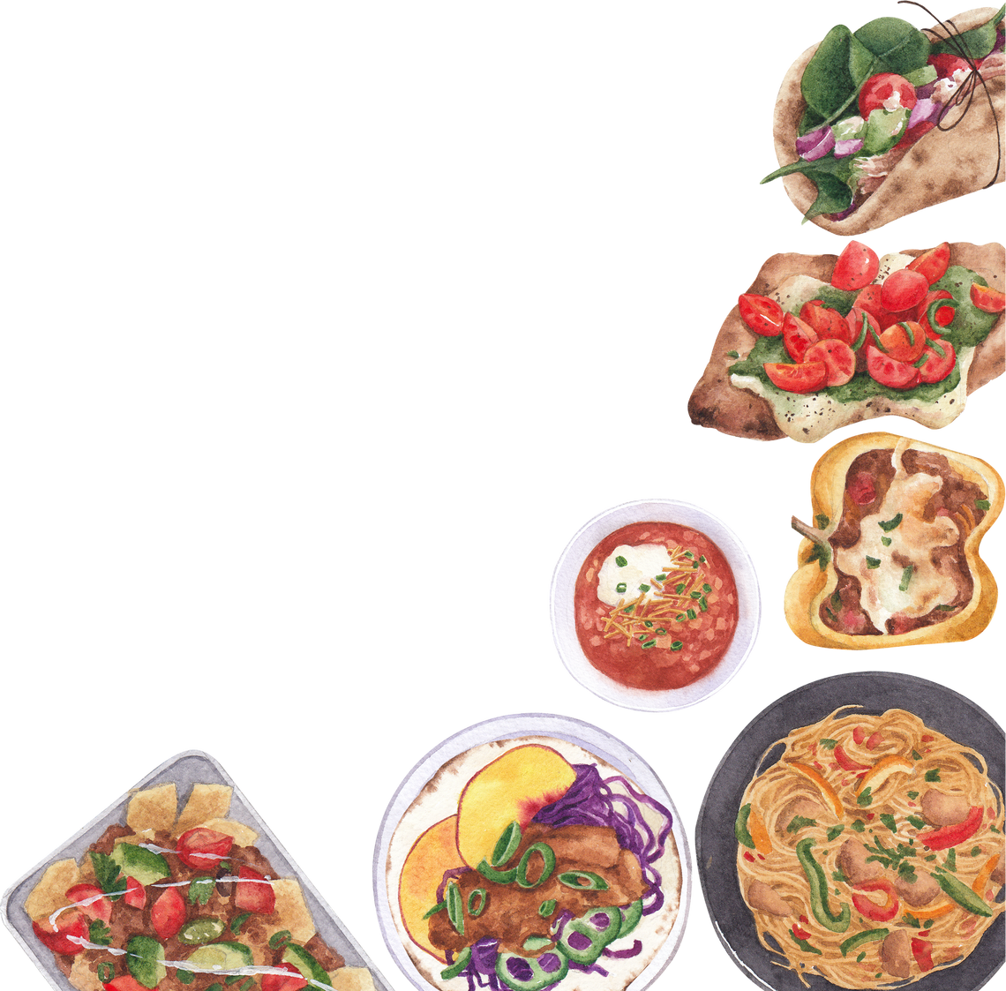
KMEANS RESULTS
Pick cluster 1 : CA where the UCLA campus
Filter the restaurants/food in CA
Apply BERT to explore more categories popular in CA

Slide 16

RECOMMEDATION
distance-based
content-based
Calculate the distance from UCLA to all the restaurants in CA using geospatial library (distance between two data points)
There is a limitation in the dataset, due to the threshold being high
Calculate the average ratings, variance measures for threshold for the recommendation
Base on result from first dataset and threshold to decide which restaurant to suggest

Slide 17

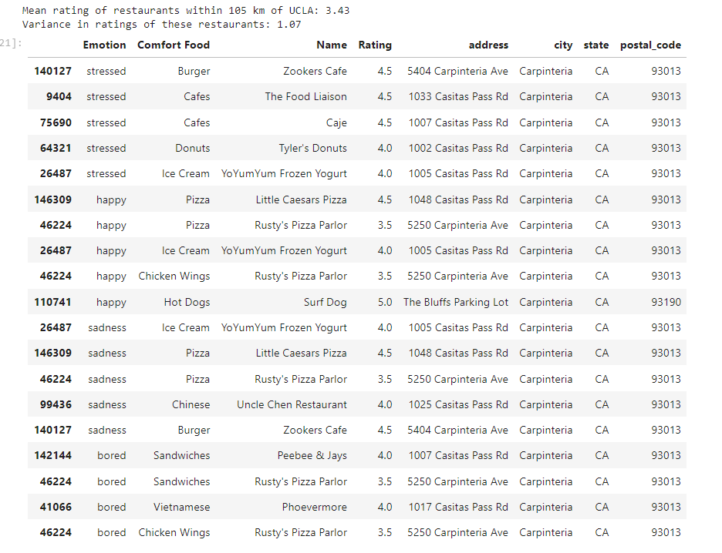
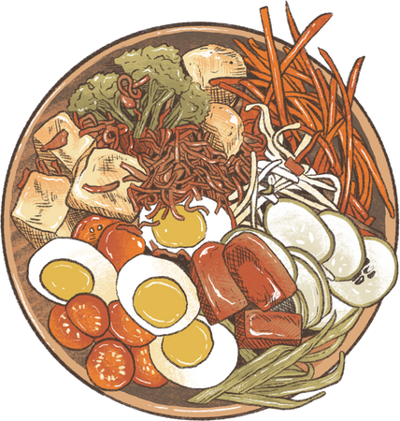

RESULT

Slide 18


REAL APPLICATION
User Experience
Implementation
Front End
HTML/CSS
HTMX
Back End
Python
Flask
Emotion Selector
Food Reccomendation
Restaurant Reccomendation

Slide 19
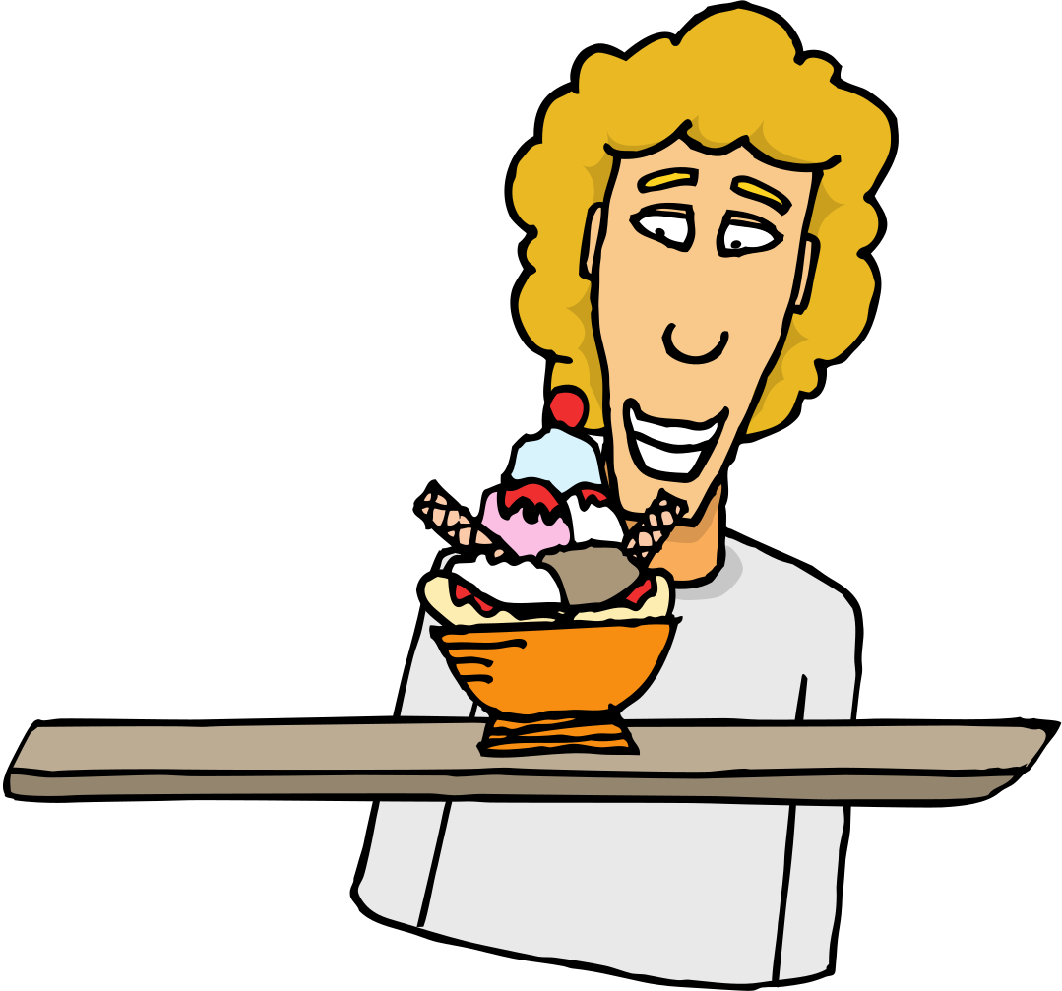

CONCLUSION
We utilized multiple data mining techniques to help improve the quality and understanding of the dataset. It provided us with a more dynamic and detailed visualization, leading to more accurate recommendations in our project

Slide 20



THANK YOU
GROUP 6

